Slide 1
Data Curation
Team members: Somanshu Gupta, A20348759
Pradeep Thapaliya,A20473870,
Shubham Tiwari, A20499153

Slide 2
Data Curation
It is the active and on-going management of data through its lifecycle and interest and usefulness to scholarship, science, and education; curation activities enable data discovery and retrieval, maintain quality, add value, and provide for re-use over time
Objective of Data Curation:-
Adding the value to data

Slide 3
Steps Of Data Curation
Documenting The Data
Asking Questions
Translating Into Open Formats
Accessing FAIRness ( Findable, Accessible, Interoperable, Reusable )
Cleaning & Validating

Slide 4
Dataset Details
Objective of Dataset :- To illustrate the conflict behavior geographically that resulted into fatal outcome. Name :- Conflicts_Events.csv Type :- Disaggregated Total Tuples :- 261865 Total Attributes :- 49

Slide 5
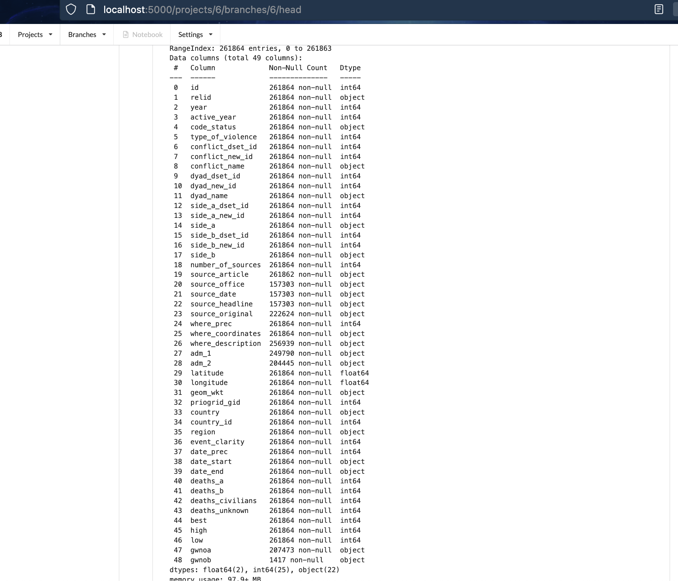
Dataset Fields Overview

Slide 6
Meta Data Information
Field Name | Description
id | unique id of event
relid | N/A
year | year of event
active_year | 1 :- active event, 0 :- non active
type_of_violence | 1: State Based 2: Non-State Based 3: One Sided
code_status | Value = Clear
conflict_new_id | conflict identification code
conflict_name | Name of conflict
dyad_new_id | Unique identification Code of individual dyad
dyad_name | Name of the conflict dyad creating the event
side_a_new_id | unique id of side a

Slide 7
Meta Data Information
Field Name | Description
side_a | name of side a
side_b_new_id | unique id of side b
side_b | name of side b
number_of_sources | total sources covering those events
source_article | name,date, titles of source material
source_office | source material publishing organization
source_date | date of source materials
source_headline | title of source material
source_original | name or type of person or organization about the event
where_prec | N/A
where_coordinates | Name of the location, to which event is assigned

Slide 8
Meta Data Information
Field Name | Description
where_description | Location Name
adm_1 | Largest Admin Division
adm_2 | Second Largest Admin Division
latitude | Latitude
longitude | Longitude
geom_wkt | Open Geospatial Consortium Textual Representation of the location
country | Name of the country
country_id | Gleditsch & Ward number Of the country
region | Region of the event
date_prec | N/A
date_start | N/A

Slide 9
Meta Data Information
Field Name | Description
date_end | N/A
deaths_a | Best Estimate Of Deaths by Side a
deaths_b | Best Estimate of Deaths by Side b
deaths_civilians
deaths_unknown | Unknown deaths
best | Best Estimate Of Total Fatalities ( Sum of death_a + death_b + death_civilians + death_unknown )
high | Highest Reliable Estimate Of Total Fatalities
low | Lowest Reliable Estimate of Total Fatalities
Notes:
a novel rapid autofocus camera for active refocusing of the iris area of the moving objects with a focus-tunable lens.
Focus Tunable Lens: Tunable lens is defined as a light focusing medium (in the form of either a fluid, a gel or a solid) that is able to use an input electrical energy to dynamically modulate its focal length. focus tunable lens are smaller, faster, and more compact than traditional autofocus designs.
Defocus Blur: A loss of sharpness that occurs when the light source is off the image focal plane

Slide 10
Data Discrepancies
Missing Values
Irrelevant Fields
Mismatch Values
Matching Issue
Entity Resolution

Slide 11
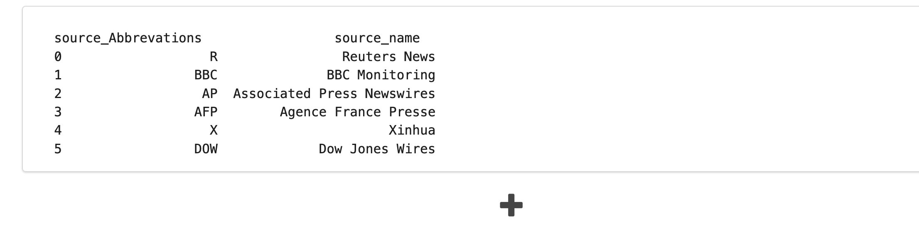
Master Table ( Dataframe )
Note :- Dataframe will have all the sources, which are present in the source_article, this will act as a references of all sources
will help in mapping and imputing the missing fields.

Slide 12
Missing Values Problem Description
*****************************Missing Values Attributes*********************************
source_article | source_office | source_date | source_original | source_headline
Depends
Depends
Depends

Slide 13
Missing Values Problem Dataset Example
****************************Missing Values Attributes*******************************
Cases | source_article | source_office | source_date | source_original | source_headline
CASE 1 | "AFP,2007-02-26 ";"AFP,2007-02-27,.";"AFP,2007-04-06,." | Missing | Missing | Missing | Missing
CASE 2 | "AFP ,1990-06-06,ARMY HANDS OVER UNIVERSITY.";"Reuters,1990-06-06,GOVERNMENT HANDS OVER UNIVERSITY AFTER ARMY OCCUPATION. ";"BBC,1990-06-09,ARMY HANDS OVER UNIVERSITY. " | AFP;Reuters;BBC | Missing | Missing | Missing

Slide 14
Missing Values Handling
Case 1 Handling
source_original & source_headline will be imputed with “NA” , as we have no way to find out the exact source.
Note :- source_article and other fields which contains multiple values separated by separator is considered as list of items which will be exploded prior to imputing the values , it will be normalized.
source_article | source_date | source_headline | source_original | source_office
"AFP,2007-02-26 ";"AFP,2007-02-27,.";"AFP,2007-04-06,." | (2007-02-26; 2007-02-27; 2007-04-06) | NA | NA | AFP;AFP;AFP
Extracted
Extracted

Slide 15
Missing Values Handling
Case 2 Handling
source_original will be imputed with “NA” , as we have no way to find out the exact source.
source_article | source_date | source_headline | source_original | source_office
"AFP ,1990-06-06,ARMY HANDS OVER UNIVERSITY.";"Reuters,1990-06-06,GOVERNMENT HANDS OVER UNIVERSITY AFTER ARMY OCCUPATION. ";"BBC,1990-06-09,ARMY HANDS OVER UNIVERSITY. " | (1990-06-06; 1990-06-06; 1990-06-09) | (ARMY HANDS OVER UNIVERSITY, GOVERNMENT HANDS OVER UNIVERSITY AFTER ARMY OCCUPATION, ARMY HANDS OVER UNIVERSITY) | NA | AFP;Reuters;BBC
Extracted

Slide 16
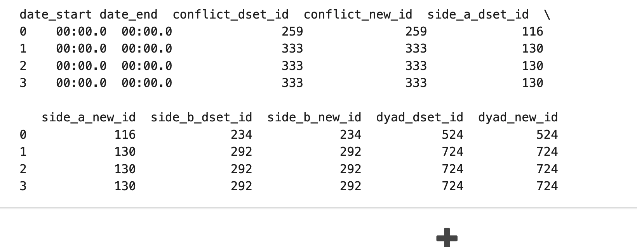
Irrelevant Fields Problem Description
date_start | date_end | conflict_dset_id | conflict_new_id | side_a_dset_id | side_a_new_id | side_b_dset_id | side_b_new_id | dyad_dset_id | dyad_new_id
Empty Dates
Identical
Identical
Identical
Identical

Slide 17
Irrelevant Fields Handling
date_start | date_end | conflict_dset_id | conflict_new_id | side_a_dset_id | side_a_new_id | side_b_dset_id | side_b_new_id | dyad_dset_id | dyad_new_id
Empty Dates
Compare
Compare
Compare
Compare
DROP
If Percentage Change == 0 {
//Drop }

Slide 18
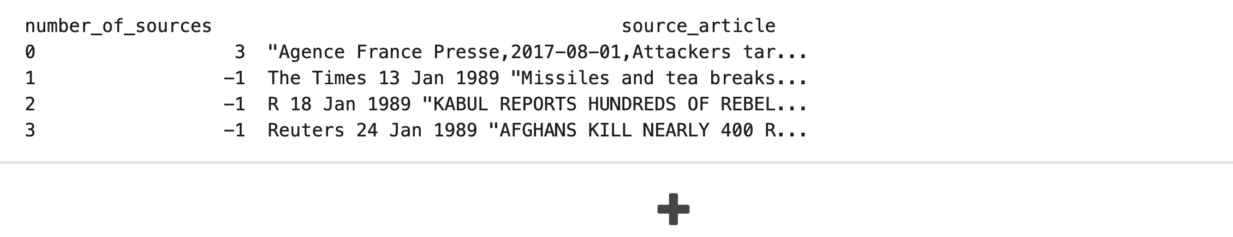
Mismatch Problem Description
number_of_sources cannot be -1, as we have source information available in source_article field
number_of_sources | source_article
3 | "Agence France Presse,2017-08-01,Attackers target Shiite mosque in Afghanistan's Herat";"Agence France Presse,2017-08-01,At least 20 killed in Shiite mosque attack in Afghanistan's Herat";"Pajhwok News,2017-07-31,Assailants among 6 killed in Iraq Embassy attack"
-1 | R 18 Jan 1989 "KABUL REPORTS HUNDREDS OF REBEL CASUALTIES IN KUNDUZ PROVINCE.
-1 | Reuters 24 Jan 1989 "AFGHANS KILL NEARLY 400 REBELS, TASS SAYS." /The Washington Post 27 Jan 1989 "Rebels Send Food Convoy To Kabul;U.S. Orders Embassy Evacuated, Closed" /The Toronto Star 28 Jan 1989 "'Atrocity' blamed on rebels' refusal to spare Kabul" / The Toronto Star 30 Jan 1989 "Battle rages for key road as diplomats depart Kabul
Depends

Slide 19
Mismatch Values Handling
number_of_sources | source_article
Old value = -1 New Value = 1 | R 18 Jan 1989 "KABUL REPORTS HUNDREDS OF REBEL CASUALTIES IN KUNDUZ PROVINCE.
Old value = -1 New Value = 1 | Reuters 24 Jan 1989 "AFGHANS KILL NEARLY 400 REBELS, TASS SAYS." /The Washington Post 27 Jan 1989 "Rebels Send Food Convoy To Kabul;U.S. Orders Embassy Evacuated, Closed" /The Toronto Star 28 Jan 1989 "'Atrocity' blamed on rebels' refusal to spare Kabul" / The Toronto Star 30 Jan 1989 "Battle rages for key road as diplomats depart Kabul
Update the count
If Exists ( Reuters, R)

Slide 20
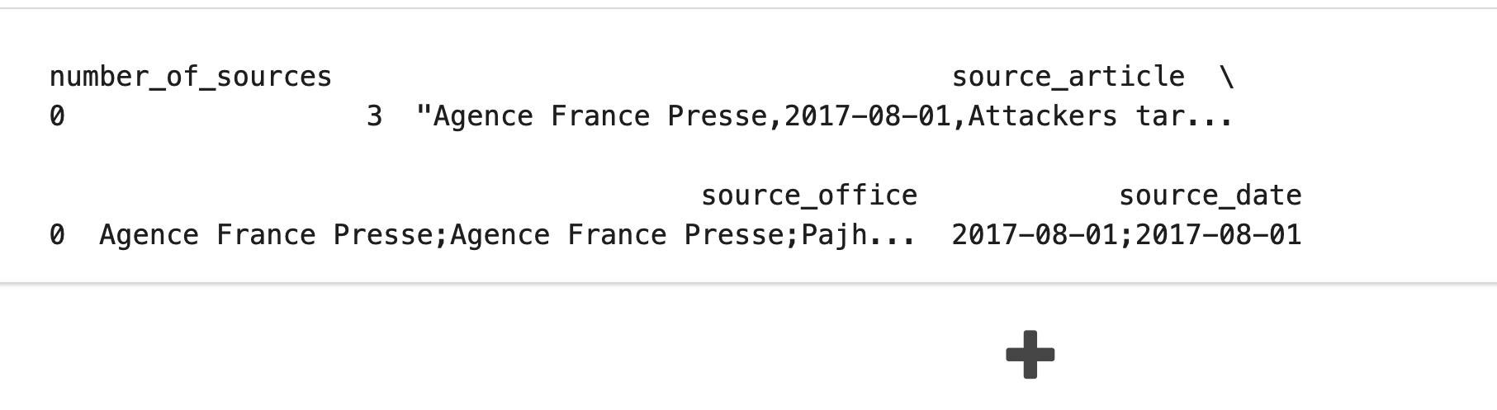
Matching Problem Description
id | source_article | source_date
244657 | "Agence France Presse,2017-08-01,Attackers target Shiite mosque in Afghanistan's Herat";"Agence France Presse,2017-08-01,At least 20 killed in Shiite mosque attack in Afghanistan's Herat";"Pajhwok News,2017-07-31,Assailants among 6 killed in Iraq Embassy attack" | 2017-08-01;2017-08-01
source_article
source_date
Agence France Presse; Agence France Presse ; Pajhwok News
2017-08-01; 2017-08-01
Which source_article should be matched to which source date ?
3 source_article
2 source_date

Slide 21
Matching Problem Handling
Original_Dataframe
New_Dataframe
id | source_article | source_date
244657 | "Agence France Presse,2017-08-01,Attackers target Shiite mosque in Afghanistan's Herat";"Agence France Presse,2017-08-01,At least 20 killed in Shiite mosque attack in Afghanistan's Herat";"Pajhwok News,2017-07-31,Assailants among 6 killed in Iraq Embassy attack" | 2017-08-01;2017-08-01
id | source_article | source_date
244657 | "Agence France Presse,2017-08-01,Attackers target Shiite mosque in Afghanistan's Herat" | 2017-08-01
244657 | “Agence France Presse,2017-08-01,At least 20 killed in Shiite mosque attack in Afghanistan's Herat” | 2017-08-01
244657 | "Pajhwok News,2017-07-31,Assailants among 6 killed in Iraq Embassy attack" | Null
Normalization
Extraction from source_article
Scrapping

Slide 22
Entity Resolution Problem ( Identifying Duplicates )
Problem :- Here both the rows contains similar strings , which may point to same entity or in other words duplicates and we don’t have any unique identifier to distinguish these two records.
Questions :-
Are “@Sahel_Seucrity” on Twitter & “@Sahel_Security” are same ?
Are “Di Village” & “Dissi Village” are same ?

Slide 23
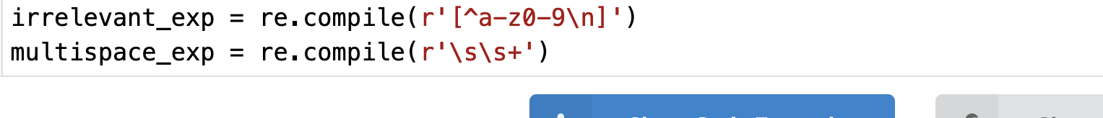
Entity Resolution Handling
Data Cleaning
We Removed special characters from strings
We Converted all characters to lower case
Removed all special characters
Kept one character space
Outcome Of Data Cleaning
To get better matching accuracy

Slide 24
Entity Resolution Handling
Geocoding Latitude & Longitude
To find the postal code for given address
Outcome Of Geocoding
To get less address variations
Postal for each location will be available

Slide 25
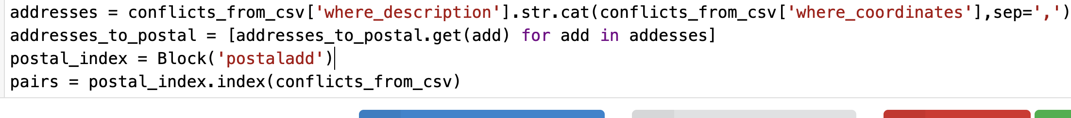
Entity Resolution Handling
Indexing & Finding Candidate Pair
To find the candidate pair for finding matches
Outcome Of Candidate Pair Generation
To avoid full index blocking ( all records against all records)
To find only those pairs that are good candidates for duplicates.

Slide 26
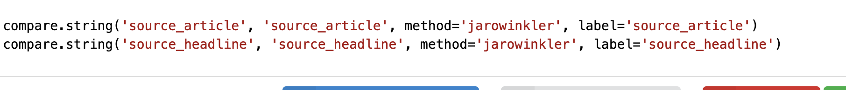
Entity Resolution Handling
Computing Comparision Vector Using Jarowinkler
To produce the comparison vector for each pair for each column generated by indexing.
Outcome Of Comparision Vector
To get an idea , how each columns are behaving in terms of similarity

Slide 27
Entity Resolution Handling
Classifying as Matches & NonMatches
With comparison vectors, we will try to classify them whether it is a match or not.
Used Threshold-Based Classification.
Outcome Of Comparision Vector
To get an idea , how each columns are behaving in terms of similarity
Note :- We are still working to get the thresholds over computed vectors that we got from jarowinkler, based on value, we may conclude whether it is a good match or not

Slide 28
Possible Improvements
Data Discrepancies | Existing Solution | Improvement Area
Missing Values | Imputing ”NA” | Web Scrapping
Matching Problem | Extracting missing field from another field | Web Scrapping
Entity Resolution Problem | Threshold Based Similarity | Natural Language Processing /Active Classification Learning Approach ( Eg :- dedupe library )

